Slide 1


The distributed (and parallel) programming: it’s all about scalability
SE3331-1 (2023 Fall)
Xingda Wei, Yubin Xia
IPADS, Shanghai Jiao Tong University
https://www.sjtu.edu.cn
Credits: AI-sys Sp22, CMU15-418

Slide 2

Systems: storage, compute and network
Storage
Power
Network
Power
Compute
Power

Slide 3

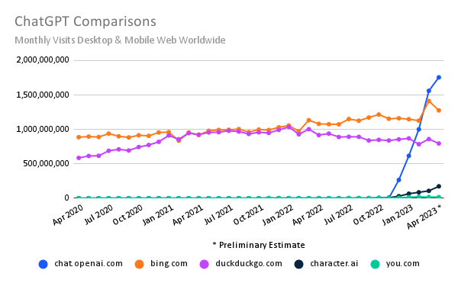
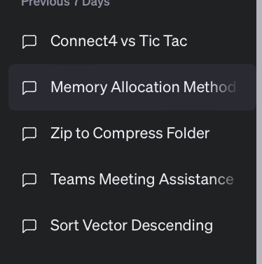
Review: Scalable web apps are everywhere: AI era
Essentially, also a web APP
  Pre-AI era: request handling = order an item
  AI era: request handling = use model to do an
  inference
The same system requirements
  High request rate
  Massive data: both for training & for serving
  history data
New requirements
  Huge computation power required
  According to GPT (☺), an inference of GPT
  ~= sorting 100,000,000 numbers
Per-user sessions
Notes:
ChatGPT access data: https://www.similarweb.com/blog/insights/ai-news/chatgpt-growth-flattens/
要确切地回答GPT-4运行一次推理所需的计算能力与传统计算（如排序）的等价关系，需要具体地了解两个任务的计算复杂性和所用的硬件。然而，我们可以对这个问题进行一个简化的概述。
GPT-4的推理:
GPT-4进行一次推理（即生成一个响应）通常只涉及前向传播，而不涉及训练。这意味着每个神经元需要与其输入进行一次乘法操作，然后加上一个偏差，并通过激活函数。
由于GPT-4有数十亿的参数，所以每次推理需要数十亿的这样的操作。这还取决于所选的序列长度和模型配置。
排序:
最常用的排序算法，如快速排序或归并排序，具有O(n log n)的平均时间复杂性，其中n是待排序的元素数量。
如果我们要排序1亿个数字，所需的操作数将是在10亿到100亿之间，这取决于常数因子和排序的数据。
如果我们进行一个非常粗略的比较：
对于GPT-4的一个简单推理与对1亿个数字的排序，所需的计算操作大致是同一个数量级的。
但请注意，这是一个非常简化和粗略的比较。实际上，不同的计算任务在不同的硬件上有着不同的效率，因此即使两者需要相同数量的操作，它们也可能在实际执行时间上有所不同。
此外，实际的操作复杂性和所需的计算能力取决于实际的任务参数和所使用的实现细节。

Slide 4
Question: given an AI workload, e.g., model training, how many computation does it need?

Slide 5
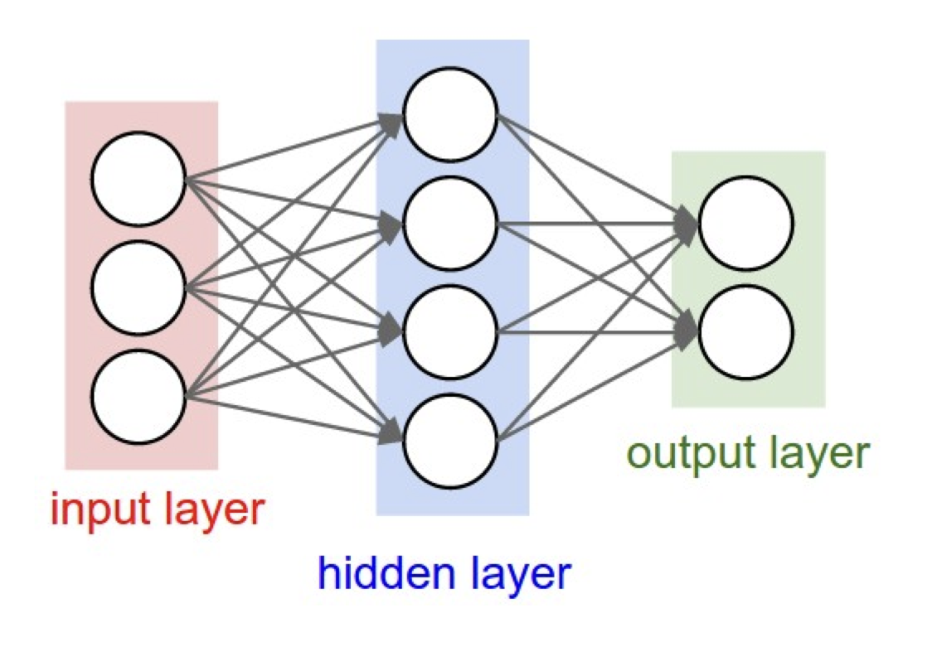
The scale of computation
Motivating example: the process of large AI models
  E.g., Current AI models are constructed via neural network (NN)
Question: given a simple NN network, how many computations are required to trained it?
  Suppose the NN has W (W1 + W2) parameters
W1
W2

Slide 6
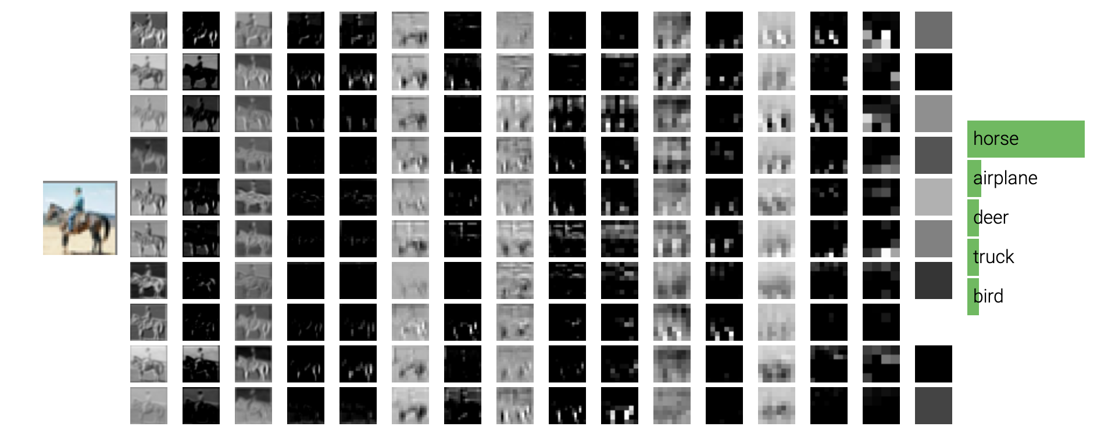
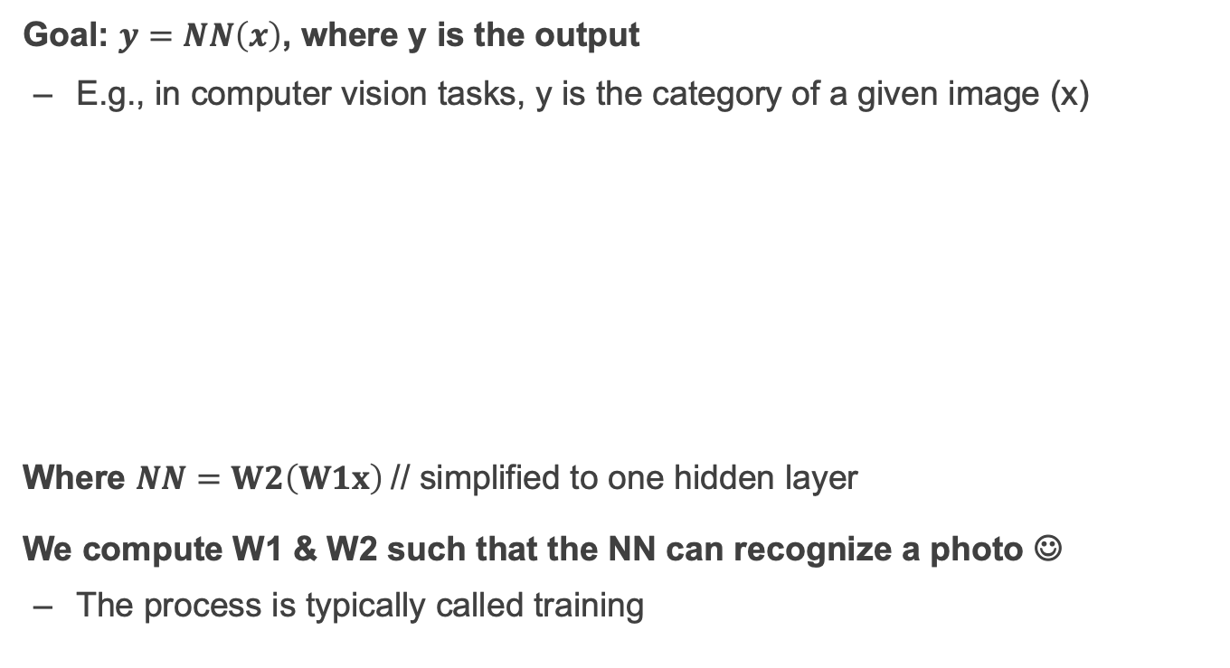
Motivating example: AI model training
Goal: $y=NN\left(x\right)$, where y is the output
  E.g., in computer vision tasks, y is the category of a given image (x)
Where $NN=W2\left(W1x\right)$// simplified to one hidden layer
We compute W1 & W2 such that the NN can recognize a photo ☺
  The process is typically called training
W1
W2

Slide 7
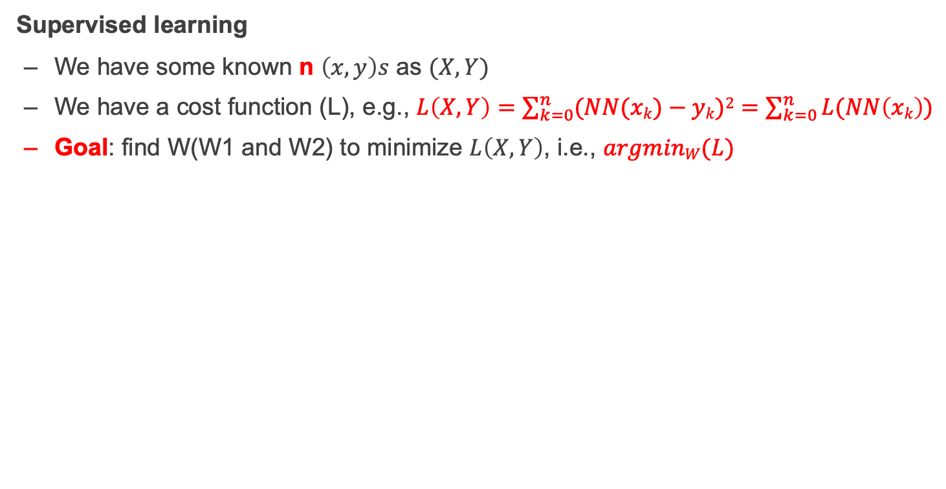

Supervised learning & gradient decent & its computation requirements
Supervised learning
  We have some known n $\left(x,y\right)s$ as $(X,Y)$
  We have a cost function (L), e.g., $L\left(X,Y\right)=\sum_{k=0}^{n}{(NN(xk)}−yk)2=$ $\sum_{k=0}^{n}{L(NN\left(xk\right))}$
  Goal: find W(W1 and W2) to minimize $L\left(X,Y\right)$, i.e., $argminW(L)$
$$cost$$

Slide 8
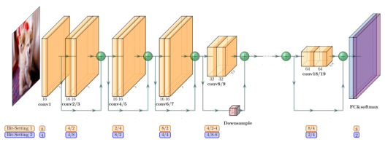
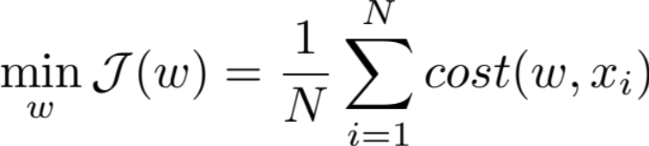
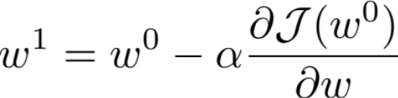

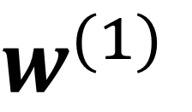
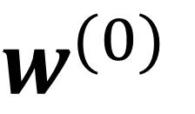

How? Gradient decent
Learning rate
Two key elements:
The computed gradient: the direction
The learning rate: how big a step do we take?

Slide 9
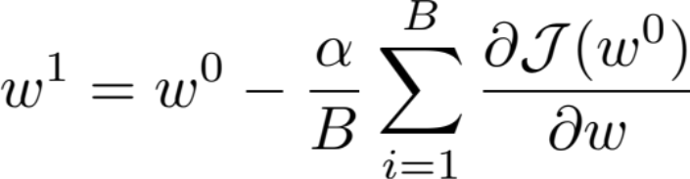
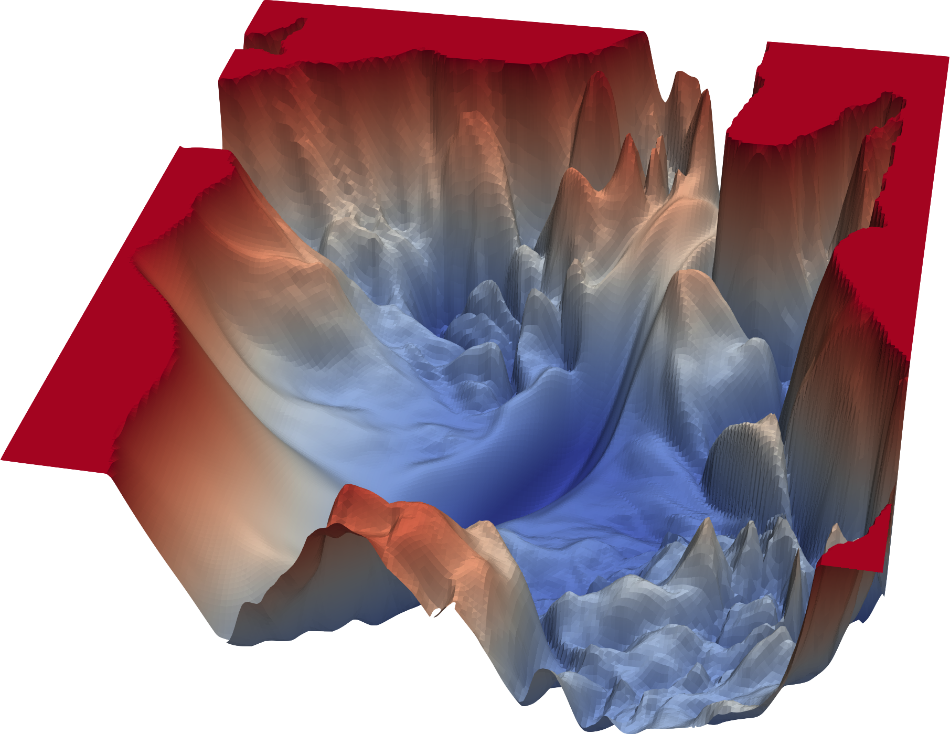
Stochastic Gradient Descent (SGD)
Learning rate
Two key elements:
The computed gradient: the direction
The learning rate: how big a step do we take?

Slide 10
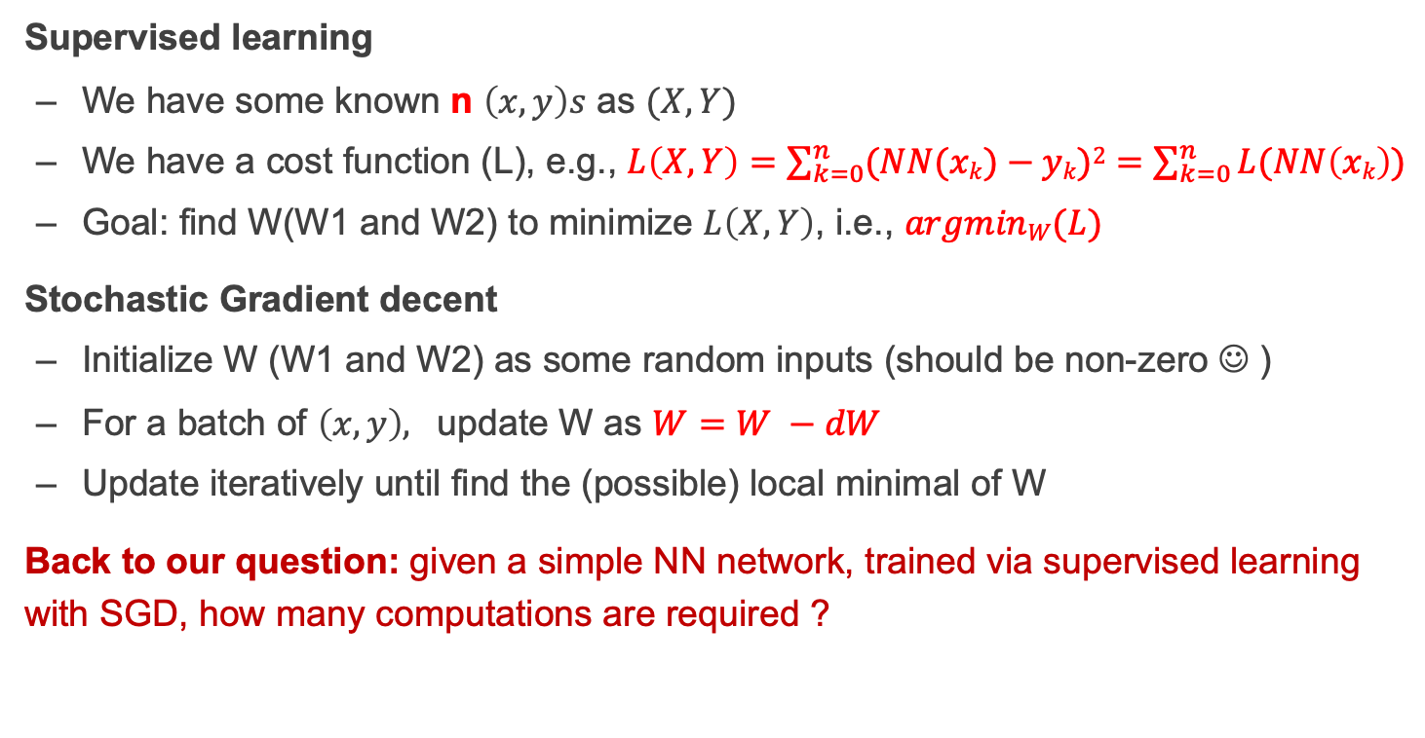
Supervised learning & gradient decent & its computation requirements
Supervised learning
  We have some known n $\left(x,y\right)s$ as $(X,Y)$
  We have a cost function (L), e.g., $L\left(X,Y\right)=\sum_{k=0}^{n}{(NN(xk)}−yk)2=$ $\sum_{k=0}^{n}{L(NN\left(xk\right))}$
  Goal: find W(W1 and W2) to minimize $L\left(X,Y\right)$, i.e., $argminW(L)$
Stochastic Gradient decent
  Initialize W (W1 and W2) as some random inputs (should be non-zero ☺ )
  For a batch of $\left(x, y\right),$ update W as $W=W −dW$
  Update iteratively until find the (possible) local minimal of W
Back to our question: given a simple NN network, trained via supervised learning with SGD, how many computations are required ?
$$cost$$

Slide 11

Calculation one: forward path (for loss function)
For each layer, calculate $Y = W°X$ ($°$: matrix multiplication)
Since model is calculated layer-by-layer, we just need to focus on the calculation of one layer
Notes:
Divide and conquer

Slide 12
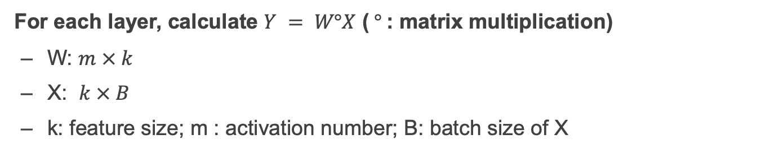
Calculation one: forward path (for loss function)
For each layer, calculate $Y = W°X$ ($°$: matrix multiplication)
  W: $m × k$
  X: $k × B$
  k: feature size; m : activation number; B: batch size of X
Approximate calculation
  (2k−1) × m×B ~= 2 x Size(W) * B
Considering all the layers
  2 x Size(W0) * B + 2 * Size (W1) * B + … = 2 * B * # parameters

Slide 13

Calculation two: backward path (for dW & dX)
For each layer, calculate $Y = W X$
Since model is calculated layer-by-layer, we just need to focus on the calculation of one layer
  Why dX? dX is used to calculate the dW of the previous layer

Slide 14
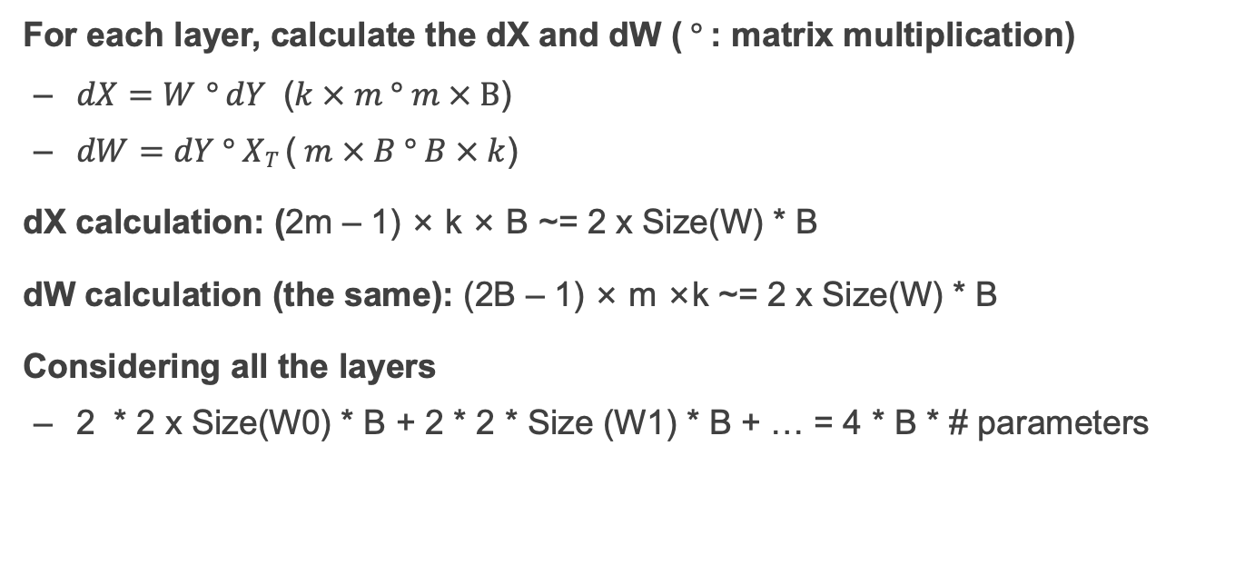
Calculation two: backward path (for dW & dX)
For each layer, calculate the dX and dW ($°$: matrix multiplication)
  $dX=W$ $°$ $dY$ ($k × m ° m × B$)
  $dW=dY ° XT$ ($m × B ° B × k$)
dX calculation: (2m – 1) × k × B ~= 2 x Size(W) * B
dW calculation (the same): (2B – 1) × m ×k ~= 2 x Size(W) * B
Considering all the layers
  2 * 2 x Size(W0) * B + 2 * 2 * Size (W1) * B + … = 4 * B * # parameters

Slide 15
Question: given an AI (model training) workload, how many computation does it need?
~= 6 * #parameters * Batch size

Slide 16
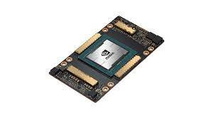
(Approximate) computation for NN like ChatGPT?
Known fact: GPT-4 has 1.76 trillion parameters ^{[1]}
  This is 1,760,000,000,000 parameters
  So, this is 10,560,000,000,000 calculations for a single input of a single iteration!!
What are the computation capabilities of nowadays devices (e.g., A100)?
  19.5 TFLOPS = 19,500,000,000,000 (FP32) float point per second
  Basically, it needs 30 seconds for an A100 GPU to finish an iteration in the optimal case
We need a powerful computation device for the AI!
[1] https://the-decoder.com/gpt-4-has-a-trillion-parameters/

Slide 17
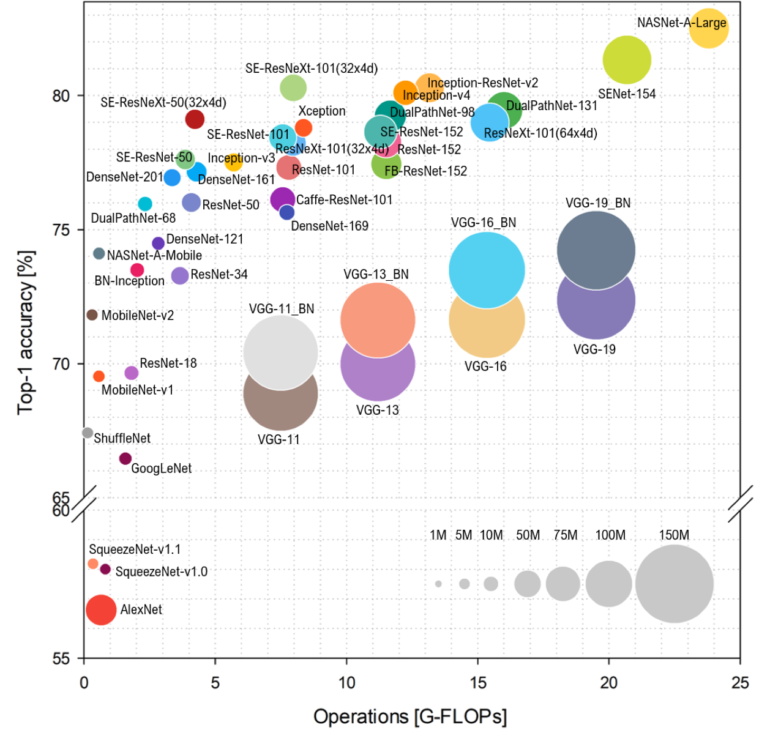

Slide 18
Devices available for computation

Slide 19
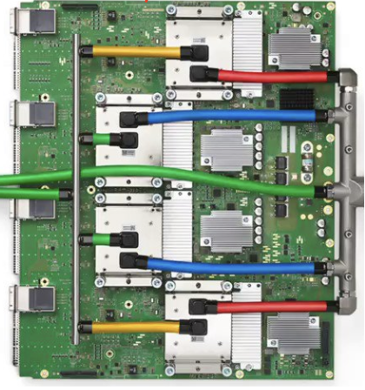



Spectrum of computation device available
Programmability
Intel i5-9600K,
single core: 6.3GFLOPS
Multiple cores: 37.7GFLOPS
Mate60 GPU
2.3 TFLOPs
Apple M2
GPU 3.6 TFLOPs
NVIDIA A100
GPU 19.5 TFLOPs
Google TPUv4
275 TFLOPS
Performance
Notes:
Source: Wikipedia
Mate60: https://nanoreview.net/en/soc-compare/qualcomm-snapdragon-875-vs-hisilicon-kirin-9000
Intel CPU: https://setiathome.berkeley.edu/cpu_list.php

Slide 20
How to scale the computation capability?
Parallelism!
Case study: single chip device

Slide 21
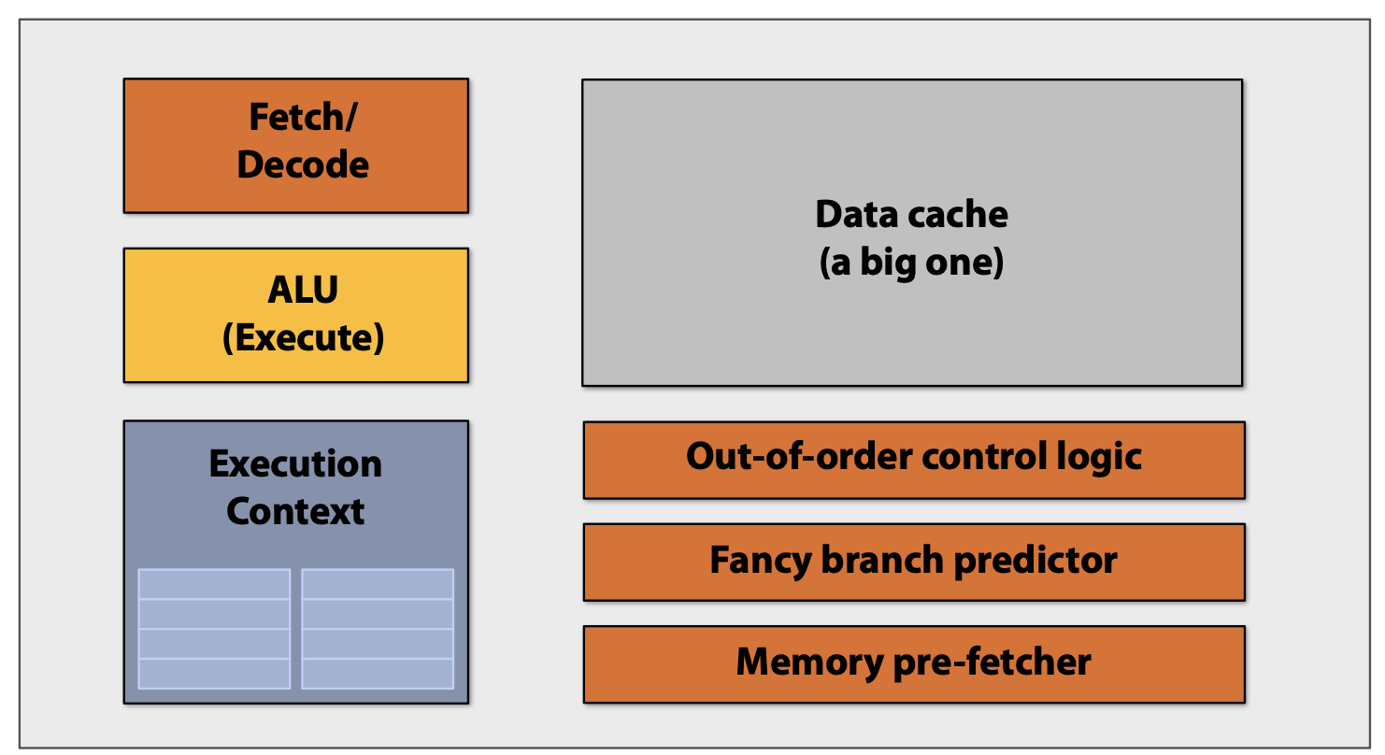
Back to the old days: the single core system

Slide 22


Review: the single core pipeline parallelism
Question
  Given a CPU core with known clock rate (e.g., 10MHz)
  How many FLOPS can it achieve?
Depends on the CPU architecture
  Suppose we have a perfect pipeline that has no bubble
  The FLOPS ~= the clock rate
Clock cycle
1
2
3
Instruction: a[0] += 1
…
Instruction: a[1] += 1
…

Slide 23
The single-core machine also have parallelism
Parallelism methods
  Pipeline
  Instruction-level parallelism (a.k.a, super scalar)
How does it scale?
  More efficient pipeline design & implementation, e.g., reduce bubble stall
  Fast clock rate, e.g., 10 MHz -> 3G Hz
  Exploiting wider instruction-level parallelism (ILP), e.g., issue 4 instructions / cycle
Optimal result: 12G Flops/sec
Notes:
Source: apple M1 has 8 decoder, so it has large instruction-level parallelism
https://news.ycombinator.com/item?id=25257932

Slide 24
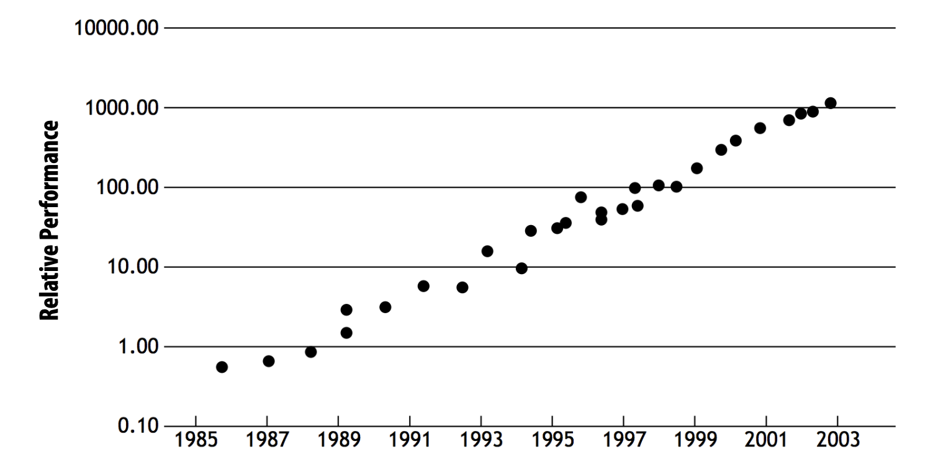
The pre-Moore law Era: single-core processor scales well
Single-core processor is growing exponentially faster

Slide 25

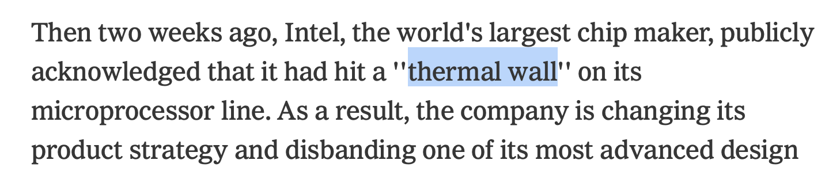
The single-core scale trend stalls quite a long time
Notes:
https://www.nytimes.com/2004/05/17/business/technology-intel-s-big-shift-after-hitting-technical-wall.html
https://en.wikipedia.org/wiki/Thermal_runaway problem

Slide 26
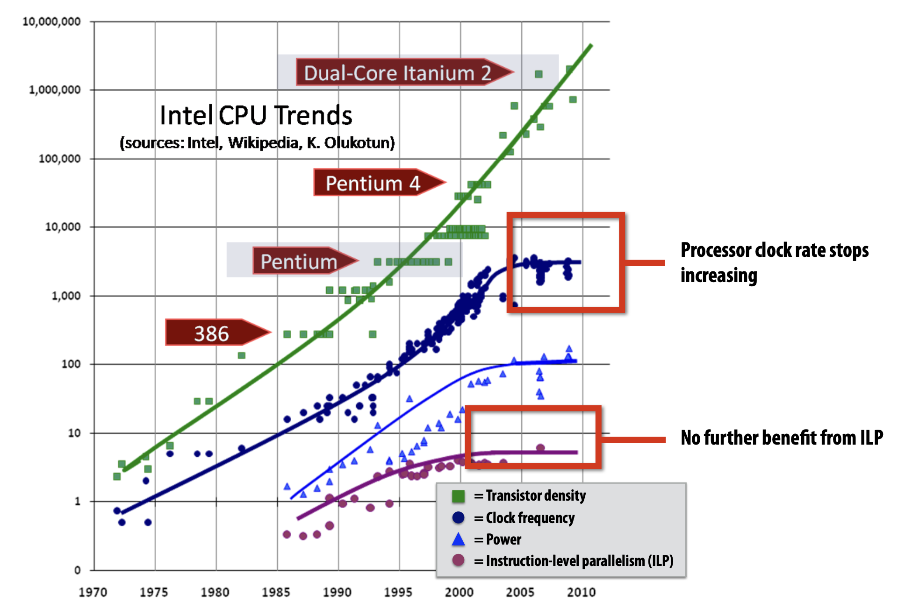
ILP tapped out + end of frequency scaling
Source: The Free Lunch Is Over: A Fundamental Turn Toward Concurrency in Software

Slide 27
Speed up computation from a programmer
Question
  How to make your program run faster?
Before 2004:
  Just wait 6 months and buy a new computer!
  (Or, build a distributed system, but not really necessary, e.g., network is slow that time)
After 2004:
  You need to write a parallel program, either on a multi-core machine or on a cluster of machines

Slide 28
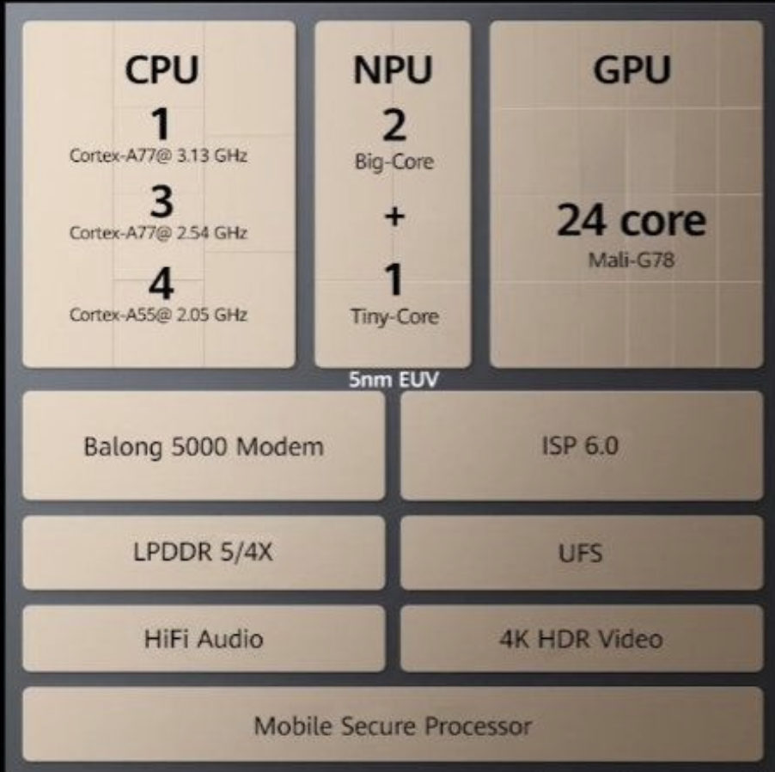
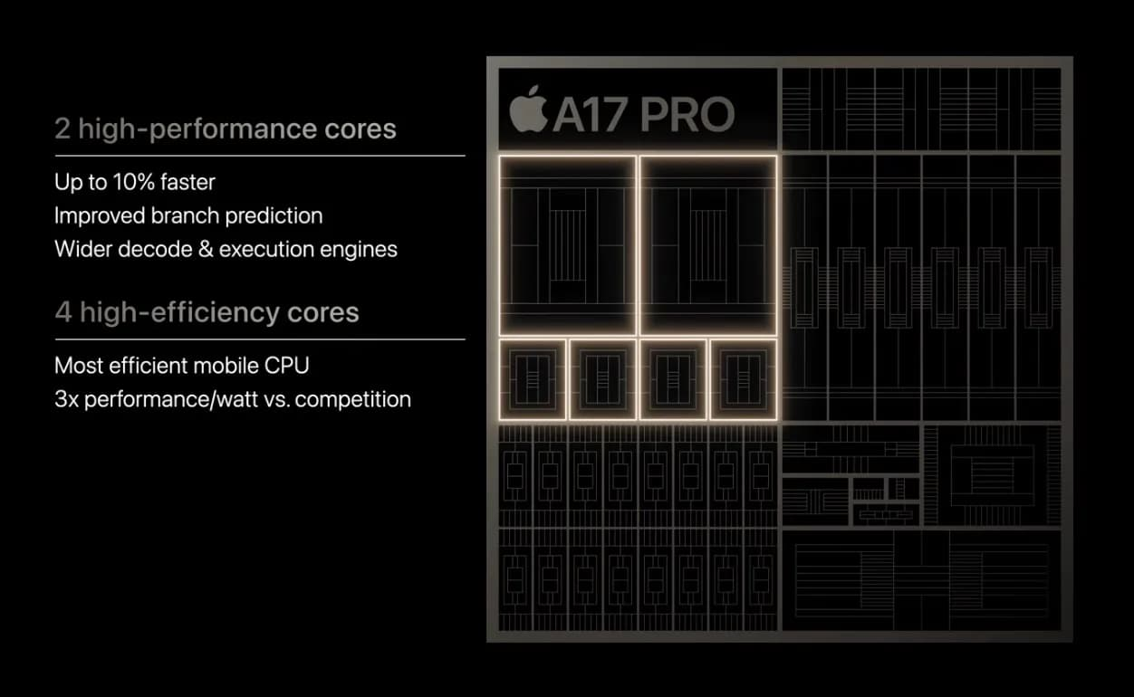



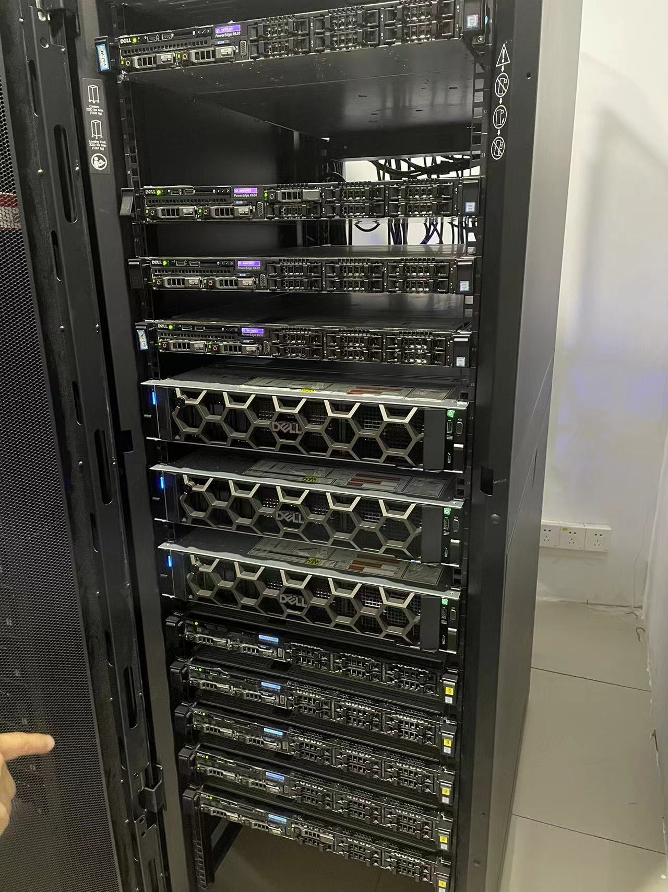
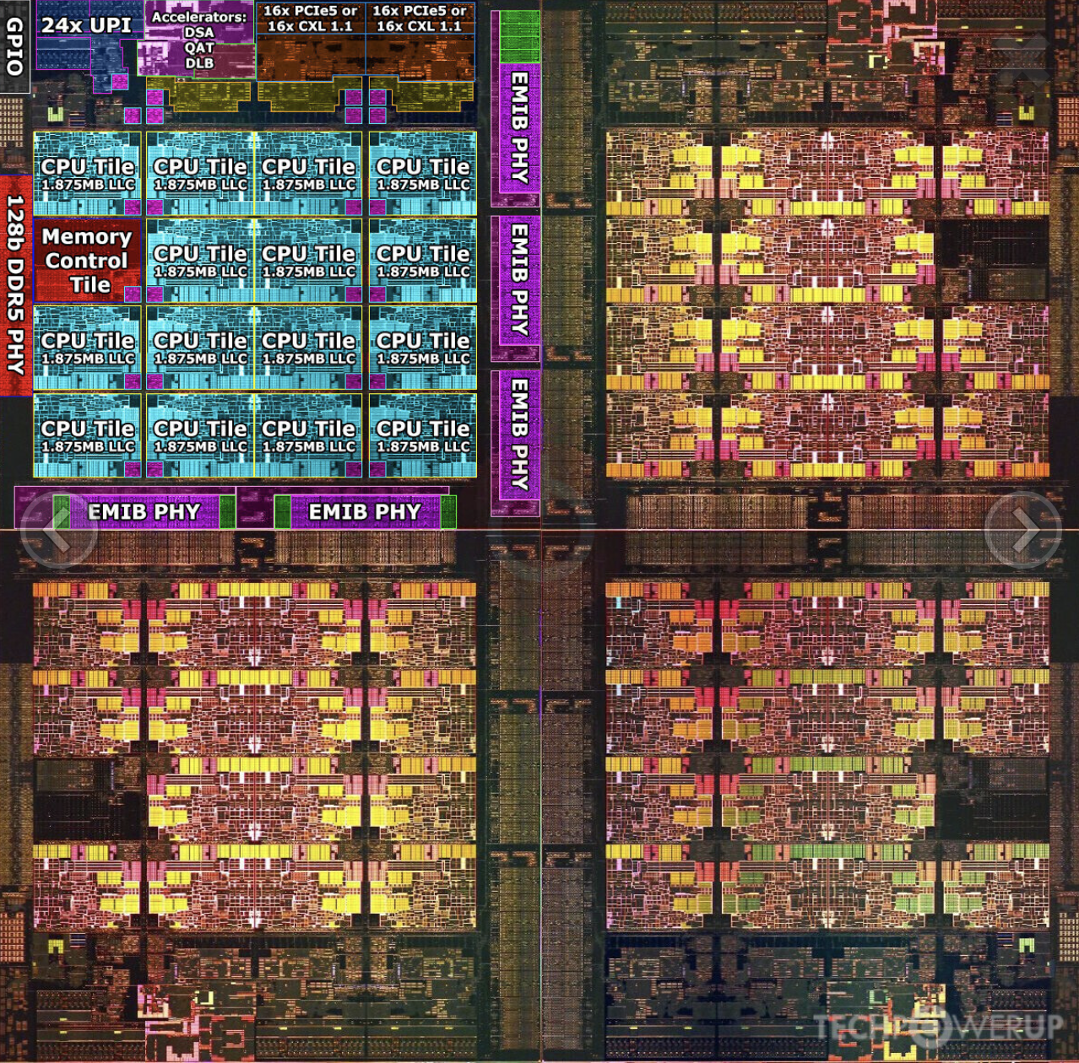

How to scale after 2004? “Glue” multi cores together
2 high performance cores + 2 high efficiency cores
1 + 3 + 4 ARM cores
64 high-performance cores on a modern datacenter server
at IPADS ☺

Slide 29
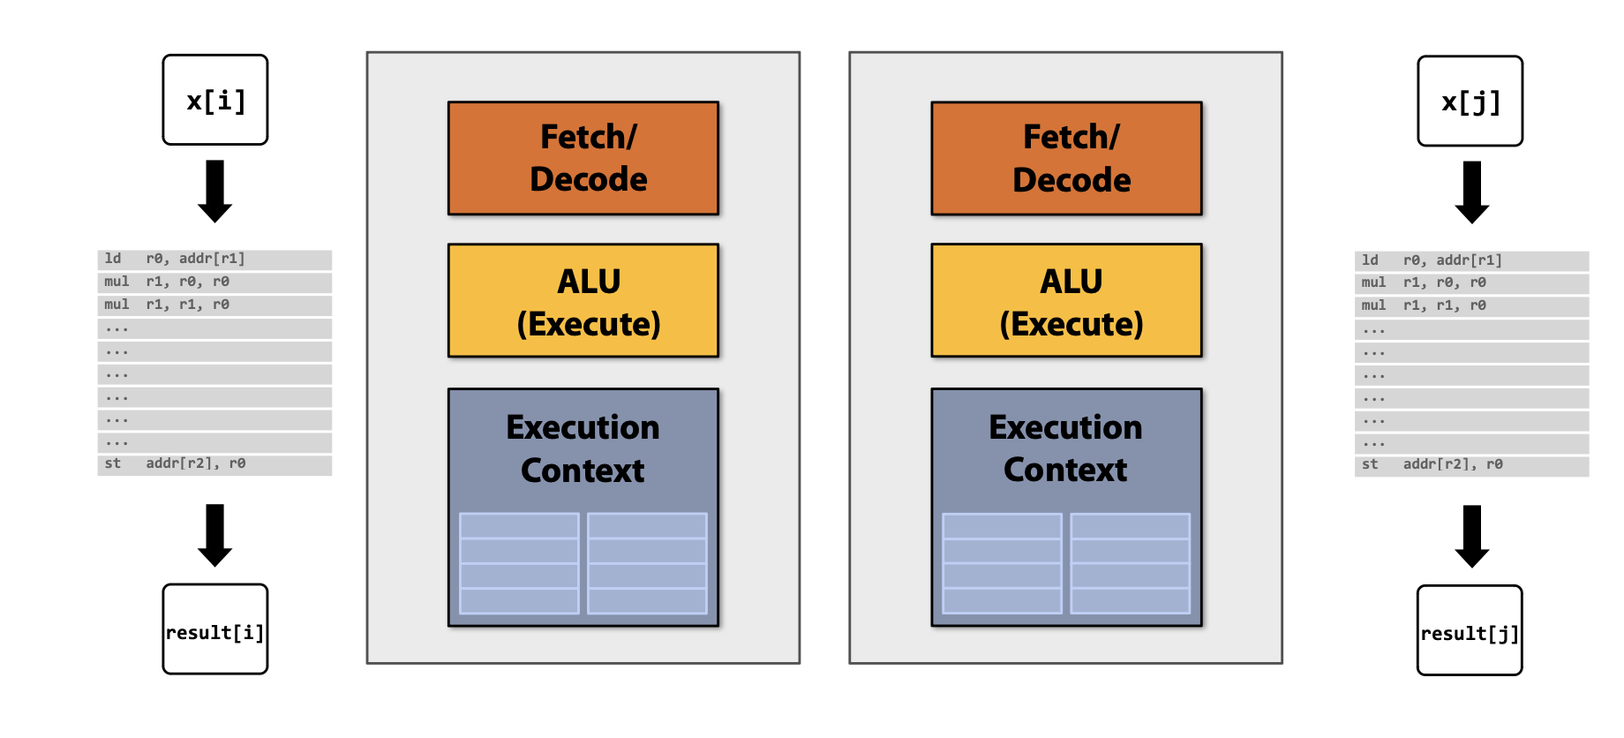
Approach #1 of multi-core: add more physical cores
Add more cores to our system
  Instead of increasing the power of fetch/decode or the entire pipeline, add multiple cores together on a simple chip

Slide 30
Example program: a simple add program
Single-core version
Multi-core version
int data[100000];
int sum = 0;
for i in 100000 :
sum += data[i]
print(sum)
int data[100000];
int sum = 0;
for i in nthreads:
start = 100000 / nthreads * i;
end = start + 100000 / nthreads;
create_thread(do_sum(start, end))
for i in nthreads:
sum += join_thread()
print(sum)

Slide 31
Exploiting physical cores with pthreads
How can a program to run on multiple cores ?
  The pthread library provides abstraction to create a thread on a multi-core CPU
int data[100];
int sum = 0;
for i in nthreads:
create_thread(do_sum(start,end))
for i in nthreads:
sum += join_thread()
print(sum)
extern int data[];
def do_sum(int start,int end) {
int local_sum = 0;
for i in start..end:
local_sum += data[i]
return local_sum
}

Slide 32
Problem: coherence under memory access hierarchy
Updates are first stored in the cache for better performance
  Without synchronization, different core’s cache may have different values
The consistency problem described earlier happens in a multi-core setting
  E.g., if core 1 writes to addr0, and core 2 should see it later

Slide 33
A quick look at the cache coherence protocols
Cache coherence protocols
  Ensure different core have a consistent view of the cached value
  E.g., informally, if core 1 made an update to cache line L1, the L1’s value will be visible to core 2 in a timely manner
Snoop-based cache (&directory-based) coherence protocol
  Each cache controller snoops all the memory reads/writes from the others
  Maybe implemented with a global directory (directory-based protocols)

Slide 34
Challenging to scale due to cache coherence protocols
Analysis of the previous protocols
  In snoop-based protocols, the #snoops increase linearly w/ the number of cores
  In directory-based protocols, the directory will become the bottleneck
Some multi-core CPUs do scale, but trade programmability
  E.g., ARM supports a relaxed consistency model, can support many cores; e.g., Huawei kunpeng 920 has 64 cores
  But, developers need to explicitly add barriers to ensure the last write has been seen by the others, e.g., fences
Modern CPU have a limited #cores on a single chip (20 – 100)
  Modern GPUs have many cores, but has no cache coherence at all

Slide 35
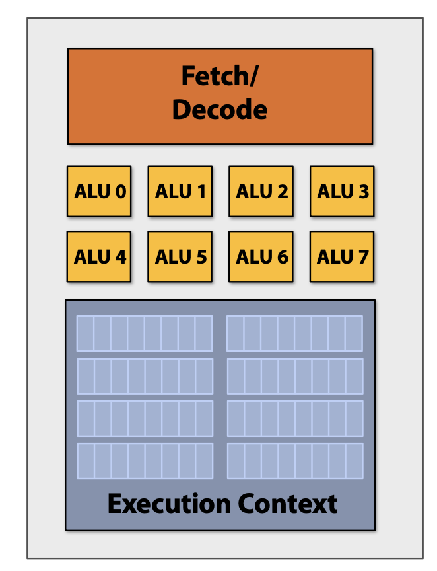
Approach #2 of multi-core: increase per-core density
More ALUs on a single core

Slide 36
Add ALUs to increase compute capability
Observation: data-parallel parallelism
  Huge computation usually means operate on a huge amount of data
  Yet, the computation (instruction) on each of the data is similar
New ISA: SIMD processing
  Single instruction (e.g., read/add), multiple data
  Same instruction broadcast to multiple ALUs in parallel
Question: why not different instructions
  Cost of manage per-ALU instruction stream

Slide 37
SIMD processing with Intel’s AVX intrinsic
Example program: add two vectors
  Suppose the target machine has 256-bit SIMD width (32B = 8 x 4-bit float)
  The memory has too be aligned to enable SIMD calculation
int size = 1000000;
float* a = (float*)_mm_malloc(size * sizeof(float), 32); float* b = (float*)_mm_malloc(size * sizeof(float), 32);
float* result = (float*)_mm_malloc(size * sizeof(float), 32);

Slide 38
SIMD processing with Intel’s AVX intrinsic
Non-SIMD version
for (int i = 0; i < size; ++i) {
result[i] = a[i] + b[i];
}

Slide 39
SIMD processing with Intel’s AVX intrinsic
SIMD version
int numLanes = size / 8;
for (int i = 0; i < numLanes; ++i) {
__m256 avx_a = _mm256_load_ps(&a[i * 8]);
__m256 avx_b = _mm256_load_ps(&b[i * 8]);
__m256 avx_result = _mm256_add_ps(avx_a, avx_b);
_mm256_store_ps(&result[i * 8], avx_result);
}
int remainder = size % 8;
for (int i = size - remainder; i < size; ++i) {
result[i] = a[i] + b[i];
}

Slide 40
SIMD vs. non-SIMD version
Machine setup: Intel(R) Xeon(R) CPU E5-2650 v4 @ 2.20GHz
auto start_time_avx = std::chrono::high_resolution_clock::now();
addVectorsAVX(a, b, result, size);
auto end_time_avx = std::chrono::high_resolution_clock::now();
std::chrono::duration<double> elapsed_time_avx = end_time_avx - start_time_avx;
std::cout << "AVX execution time: " << elapsed_time_avx.count() * 1000 << " ms" << std::endl;
auto start_time_non_avx = std::chrono::high_resolution_clock::now();
addVectors(a, b, result_non_avx, size);
auto end_time_non_avx = std::chrono::high_resolution_clock::now();
std::chrono::duration<double> elapsed_time_non_avx = end_time_non_avx - start_time_non_avx;
std::cout << "Non-AVX execution time: " << elapsed_time_non_avx.count() * 1000 << " ms" << std::endl;
AVX execution time: 2.54939 ms // why not 8X faster?
Non-AVX execution time: 5.67899 ms

Slide 41
Accessing memory (or other storage) & Roofline model

Slide 42
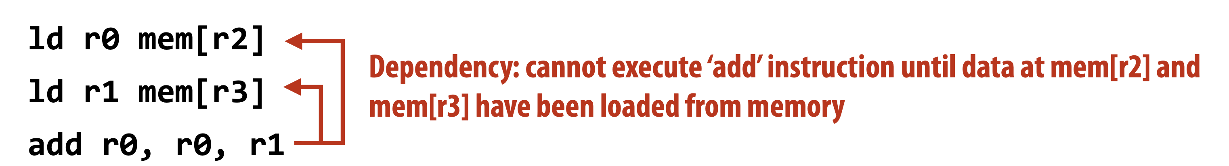
Memory stalls (Communication stalls)
A processor “stalls” when it cannot run the next instruction in an instruction stream because of a dependency on a previous instruction.
Accessing memory is a major source of stalls
Memory access times ~ 100’s of cycles
  Memory “access time” is a measure of latency
  Possible optimization: prefetching
Prefetching isn’t always possible if the memory read/write is the bottleneck

Slide 43
Terminology
Memory (storage) latency
  The amount of time for a memory request (e.g., load, store) from a processor to be serviced by the memory system
  E.g., 100 cycles (DRAM), 1us (Network in local datacenter)
Memory (storage) bandwidth
  The rate at which the memory system can provide data to a processor
  E.g., 20Gbps (Network)

Slide 44
Memory load speed
Time to load the data = Latency + Payload / bandwidth
  Note that it is the optimal case, e.g., latency and bandwidth can be affected by the others
Both factors matters
  For CPU load/store, the latency may be dominate
  For transfer large data, bandwidth will be the dominate factor
Real world problem
  What if I want to transfer 100PB data from shanghai to bejing?

Slide 45
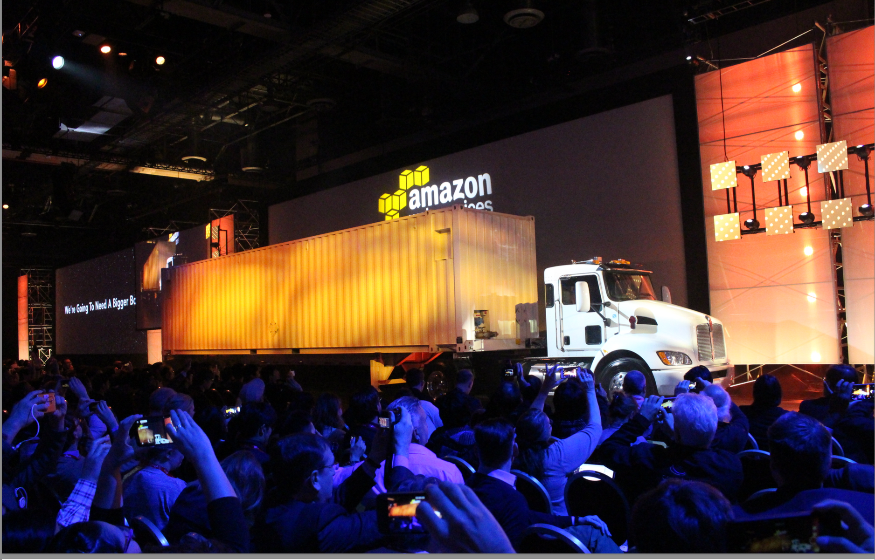
Case study: AWS Snowmobile

Slide 46
Thought experiment on load store
Example program: add two vectors
Assume vectors contain millions of elements
  Load input A[i + 8, 8]
  Load input B[i + 8, 8]
  Compute A[i, i + 8] + B[i, i + 8]
  Store output C[i, i + 8]
CPU specification (Intel(R) Xeon(R) CPU E5-2650 v4 @ 2.20GHz)
  2.2GHz, assuming 8 addition per-cycle: ~= 211 GB/s (3 * 8 4B loads per cycle)
  Memory speed: 76.8 GB/s (measured), becomes the bottleneck!

Slide 47
Roofline Model: y-axis
The y-axis describes the attained performance (of the hardware)
It’s easy to add the “peak performance” as an upper bound
128
64
Peak flops
32
16
attainable Gflop/s
8
4
2
1

Slide 48

Roofline Model: x-axis
The x-axis tells indicates for this particular application, for each floating-point operation (flop), how many bytes (B) must be fetched
For example, if we have to fetch half precision floating-point numbers for each floating point operation, then:
1 FP16: 2 Bytes (16 bits)
2 FP16: 4 Bytes (32 bits)
1 FLOP requires 4 DRAM Bytes
Usually called operational intensity (OI)
128
Different applications/kernels,
not processors, move us along the X-axis
64
32
16
attainable Gflop/s
8
4
App’s Arithmetic Intensity
2
1
¹/₈
¹/₄
¹/₂
1
2
4
8
16
Flops/Byte

Slide 49
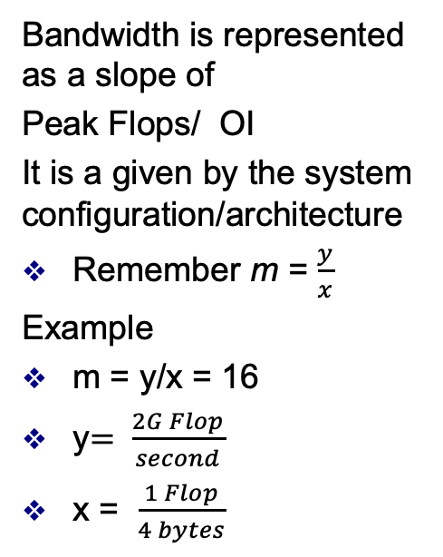
Bandwidth as Slope
128
Bandwidth is represented as a slope of
Peak Flops/ OI
It is a given by the system configuration/architecture
Remember m = $\frac{y}{x}$
Example
m = y/x = 16
y$= \frac{2G Flop}{second}$
x = $\frac{1 Flop}{4 bytes}$
64
32
16
attainable Gflop/s
Stream Bandwidth
8
4
2
1
¹/₈
¹/₄
¹/₂
1
2
4
8
16
FLOP/DRAM byte ratio
Notes:
Start from 0

Slide 50
Put it all together: the roofline model
Given an application
  If we know how many FLOPs performed per-memory read, we can see whether it is computation bound or memory bound
Benefit
  Give hints on the optimization directions
128
64
Peak flops
32
16
attainable Gflop/s
Stream Bandwidth
8
4
Kernel’s Arithmetic Intensity
2
1
¹/₈
¹/₄
¹/₂
1
2
4
8
16
flop:DRAM byte ratio

Slide 51
Back to SIMD: Modern GPU also builds around SIMD
e.g., NVIDIA GPUs
  CPU: 8 SIMD ALUs per core
  GPU: 32 (and even more) SIMD ALUs per core
Question: why GPU can have such a large amount of ALUs?
  Trade other functionalities for general-purpose computing
  E.g., no branch predictor, no cache coherence

Slide 52
Put it all together:
Approach #1 + Approach #2 are typically used together

Slide 53
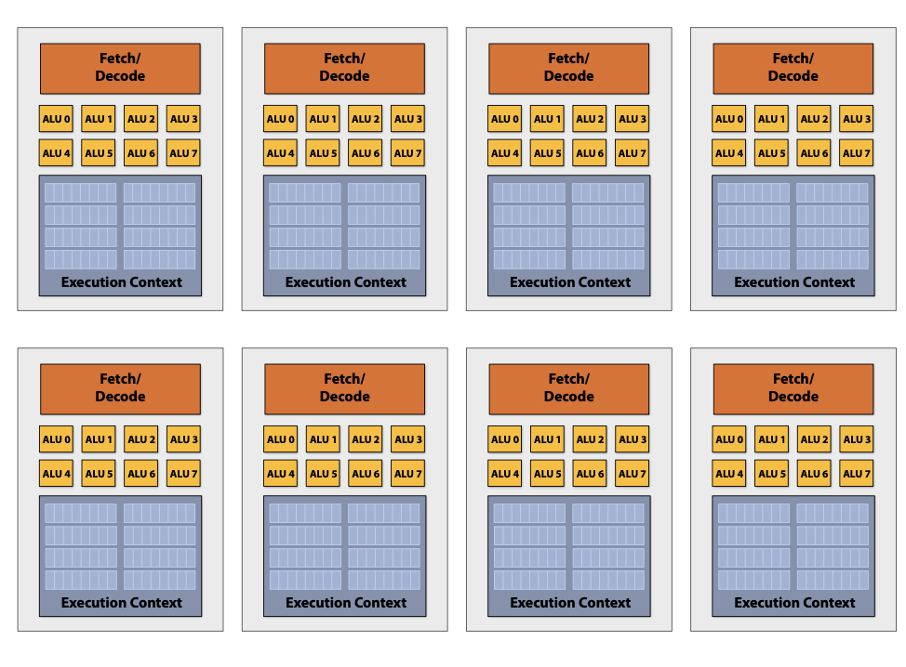
Example: Intel Core i9 (Coffee Lake)
8 cores, 8 SIMD ALUs per core

Slide 54
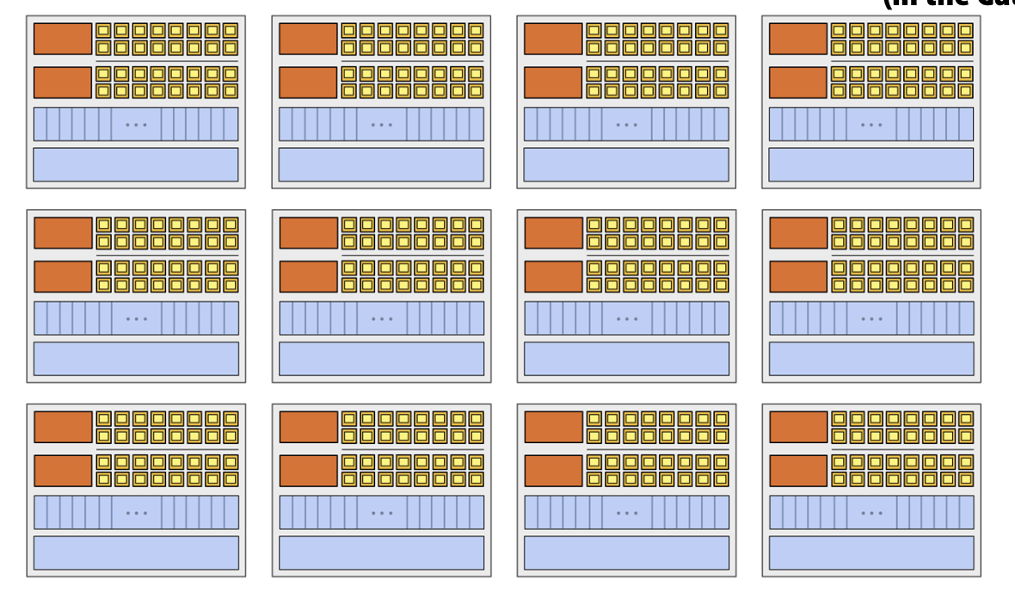
Example: NVIDIA GTX 480
15 cores, 32 SIMD ALUs per core

Slide 55
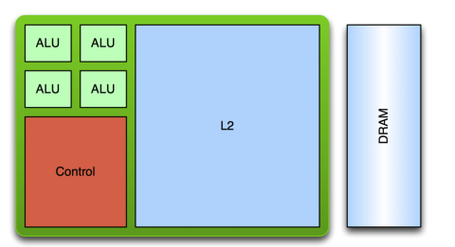
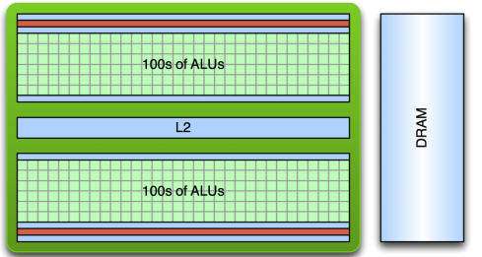
A quick comparison of CPU & GPU
CPU
  Optimized for low-latency access to cached data sets
  Control logic for out-of-order and speculative execution
GPU
  Optimized for data-parallel, throughput computation
  More transistors dedicated to computation
  Architecture tolerant of memory latency
Notes:
目前cuda没有乱序之行。
GPU的内存更快， 缓存层级更低

Slide 56
SIMD alone is insufficient
SIMD instruction is low-level
  Only simple vector add, multiple, read/write, etc.
Given the same hardware area, deploy more for computation, less for control flow
  E.g., all ALUs doing a SIMD share the same program counter
However, programs are more high-level
  E.g., how to express conditional branch using SIMD instruction?
  Question: how can we execute conditional vector add on SIMDs?

Slide 57
Conditional execution under SIMD
Constrain of SIMD: every SIMD ALUs share the same program counter (PC)
  But conditional execution have 2 (or more) branches
Solution: masked instruction
  Basic idea: execute all branches sequentially
  Each ALU has a mask to indicate whether the instruction will be executed

Slide 58
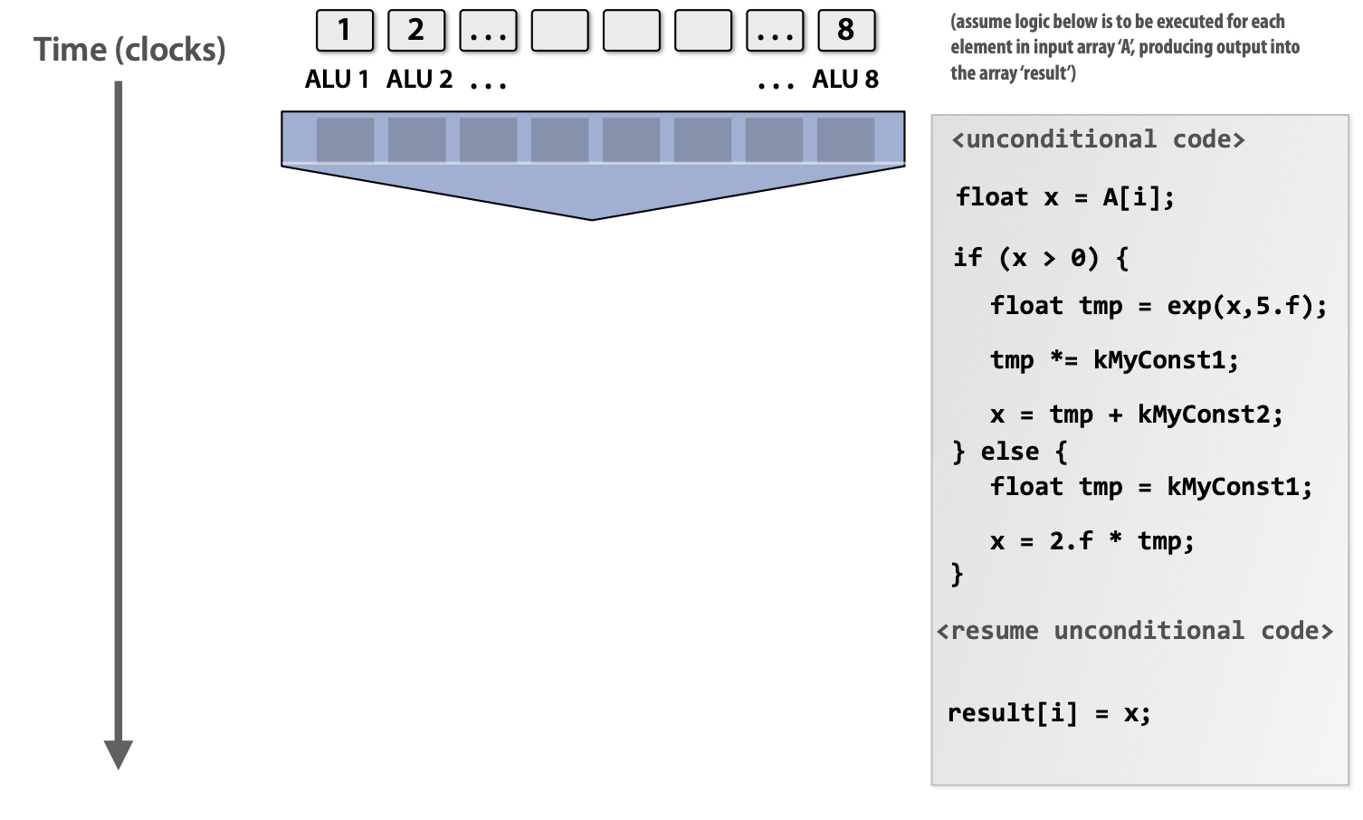
Conditional execution under SIMD

Slide 59
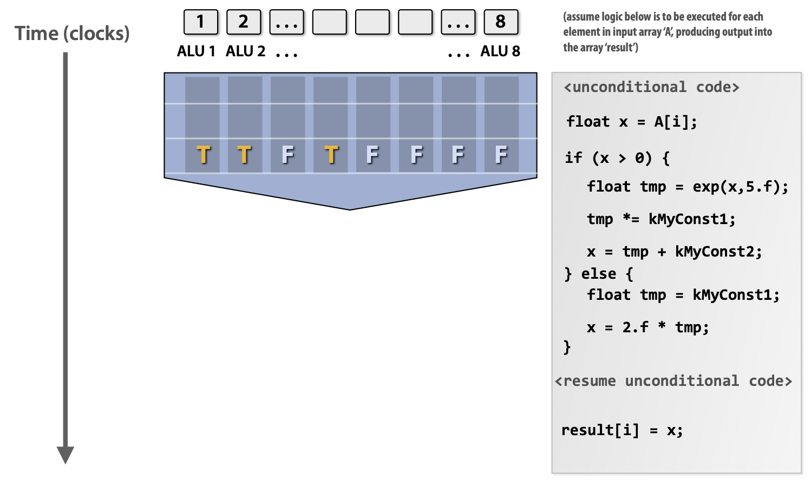
Conditional execution under SIMD

Slide 60
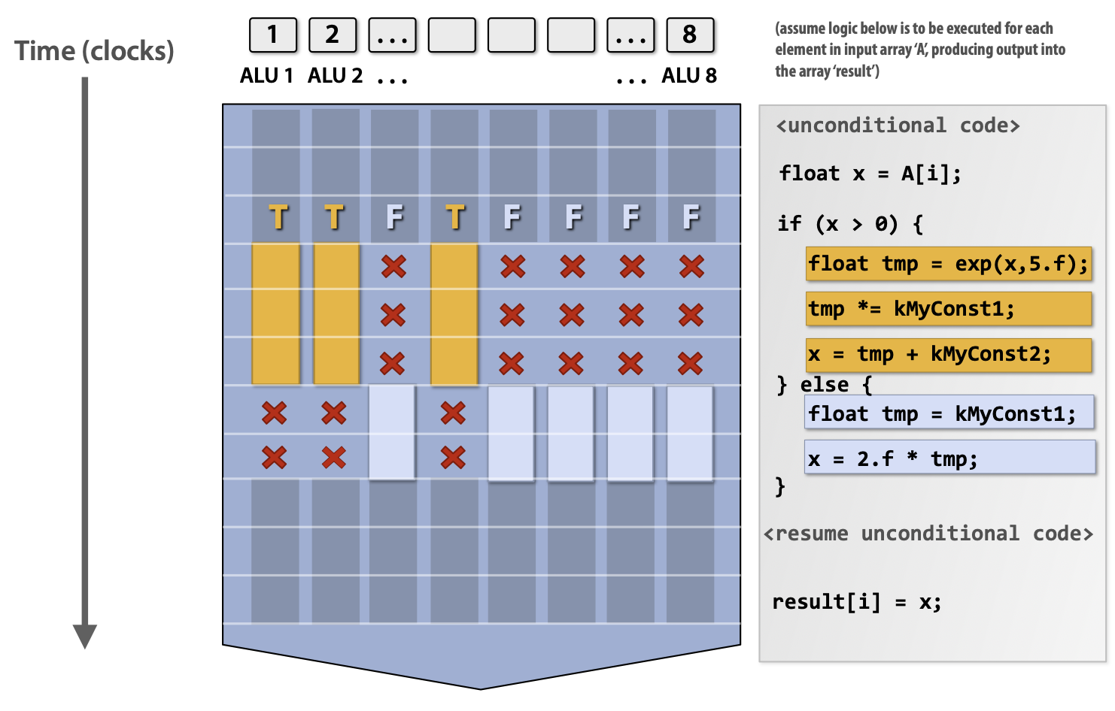
Conditional execution under SIMD

Slide 61
Conditional execution under SIMD
Challenging due to the lack of individual PC for each ALU
  Masks are needed to selectively enable ALU execution
Cons
  Waste performance: at worst case, no ALUs are enabled during execution (when all the elements take one branch)

Slide 62
Drawback of masked SIMD & the introduction of SIMT
Drawback: hard to express the conditional execution
  Programmers cannot directly call the simple vector add ops ☺
SIMT: single instruction multiple threads
  Hardware vendors provide development kit to simplify developing SIMD programs
SIMT is not a hardware implementation, but a parallel abstraction
  The programs write code assuming an abstracted SIMT model
  The compiler do necessary transformation (out of the scope of this course) to the underlying (conditional) SIMD operations
  But developers still need to consider hardware details in order to best utilize it

Slide 63
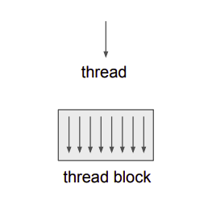
Example: SIMT and CUDA
Hardware model: SIMT
  Single instruction, multiple threads
Abstraction: C code
  Programmer writes code for a single thread using C
  All threads executes the same code
    But can take different path (control flow supported)
Threads are grouped in a block
  Threads within the same block can synchronize execution
  Each block is mapped to a GPU core for execution (we will omit details right now)

Slide 64
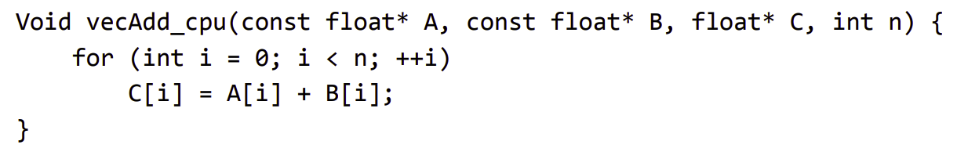
Example: vector add
Compute vector sum
  C = A + B
How to parallel it with SIMT?
  Each thread only compute the sum of one entry. There is no need to manually add the masks

Slide 65
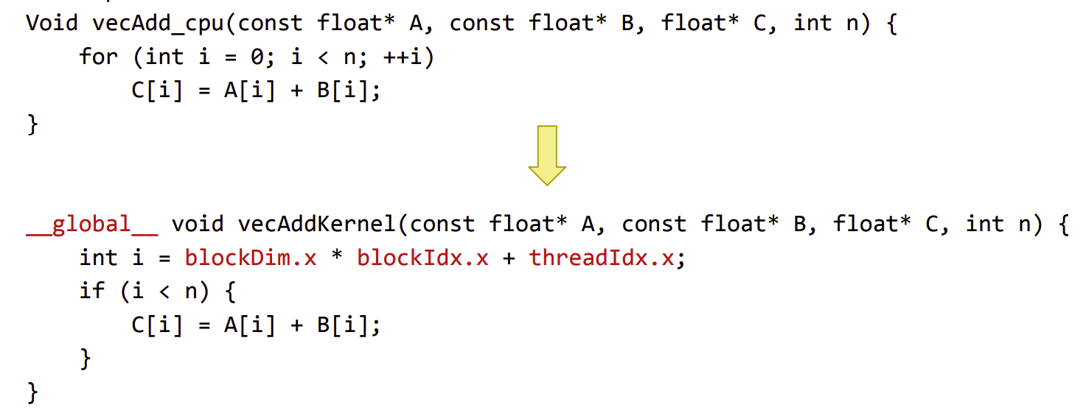
Example: vector add
Compute vector sum
  C = A + B
Notes:
这个function被所有的GPU core来执行

Slide 66
Performance of the vector add on GPU
Execution time: 28.32us (NVIDIA V100 GPU)
  In comparison: CPU time 2.54 ms w/ AVX
Note that SIMT handles many things for us
  Work distribution to multiple cores (CPU needs to use pthread)
  Conditional branches
  No need to call low-level AVX instructions
  Etc.
The comparison is not so fair, but shows the overall trend
  GPU has high bandwidth memory
  GPU has no cache coherence
  Etc.

Slide 67
Summary: parallelism on a single device
3 parallelism strategies on a single device
  Single core+: pipeline + super scalar with instruction level parallelism (ILP)
  Single core++: added SIMD support
  Multiple core: a single core (single core, single core+, single core++) can be glued together !
Question: what’s next? Single core+++++?
  Solution (Out of the scope of this lecture): domain-specific accelerators !

Slide 68
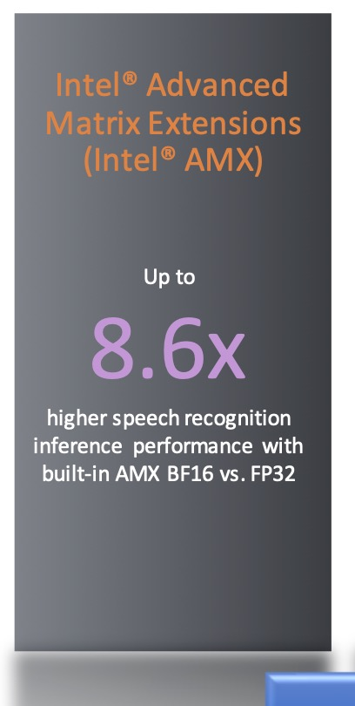
The era of domain-specific accelerators
Accelerators (even on general-purpose computing devices)
  Hardware designed to fulfill a single task
  Typically are not general-purpose, e.g., not programmable
CPU:
  SIMD + Matrix accelerators (e.g., Intel’s AMX accelerators)
GPU:
  Tensorcore: accelerators for matrix operations
TPU (Tensor processing unit):
  tensor process (optimized for large matrix operations)

Slide 69
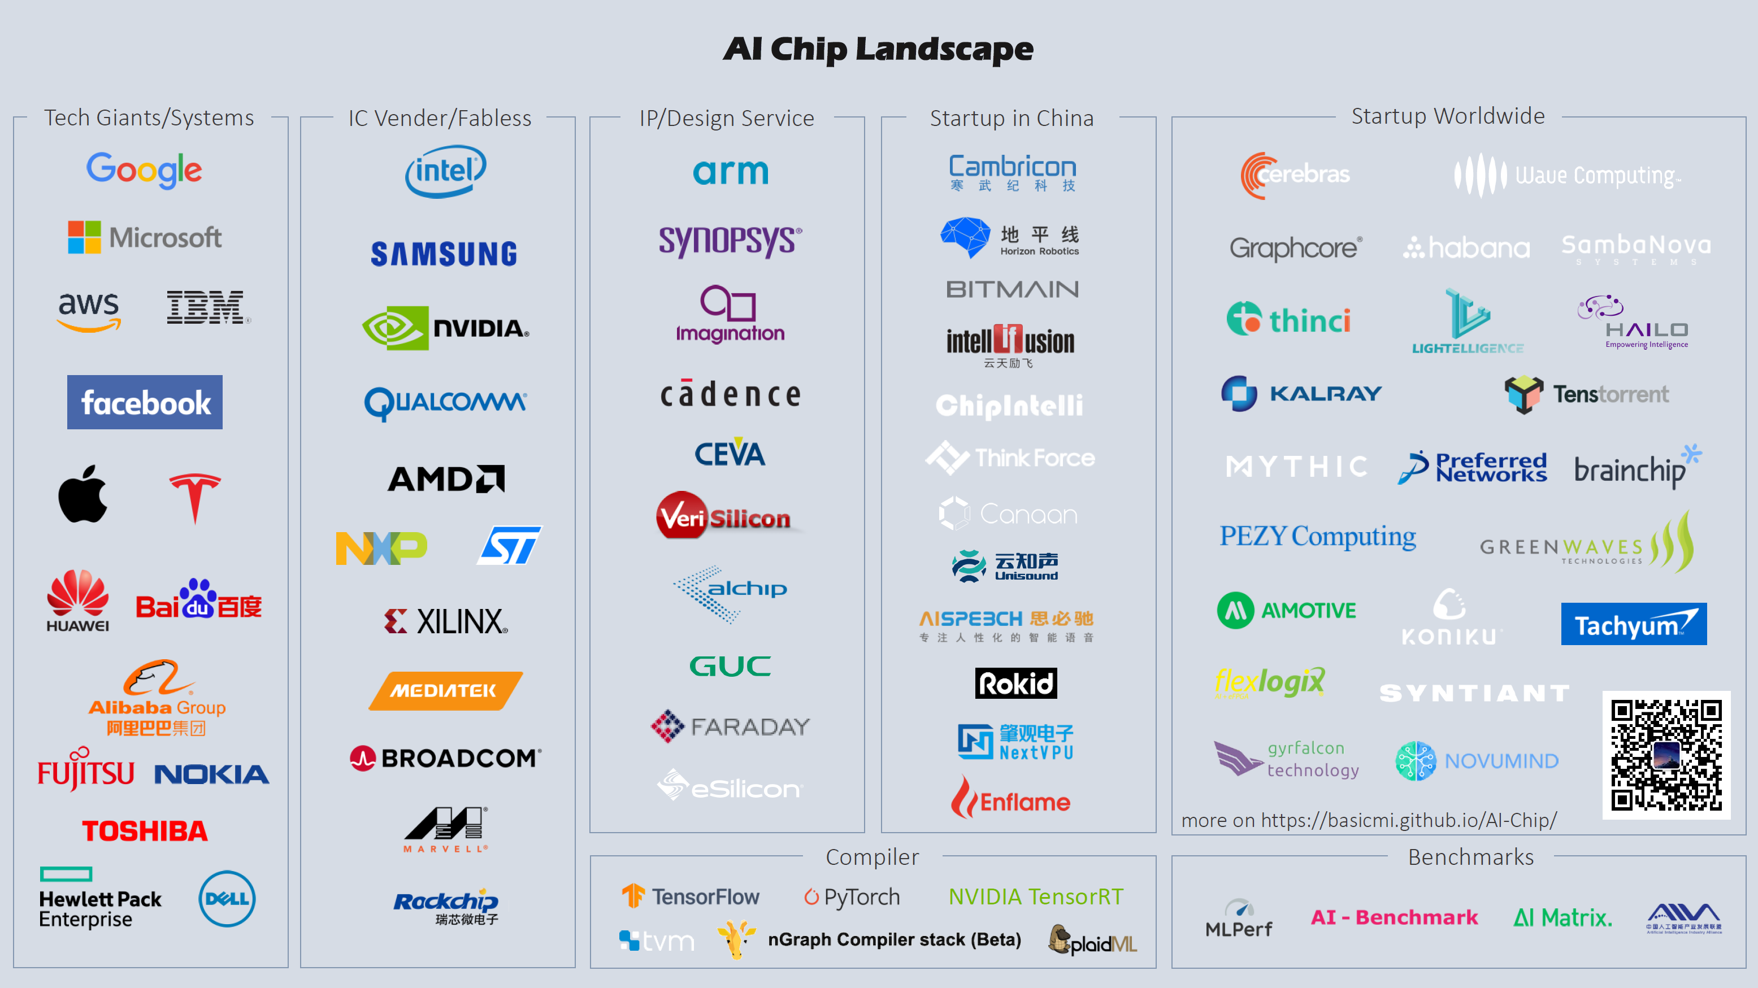

Slide 70
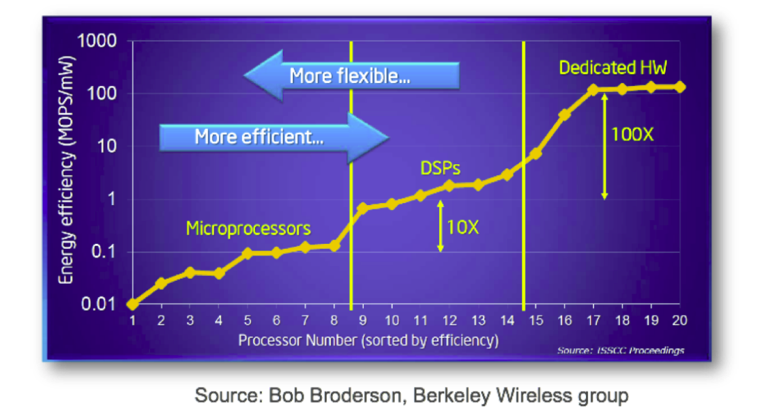
Accelerators: Flexibility vs. Efficiency Tradeoffs
Notes:
Domain-Specific Processors

Slide 71
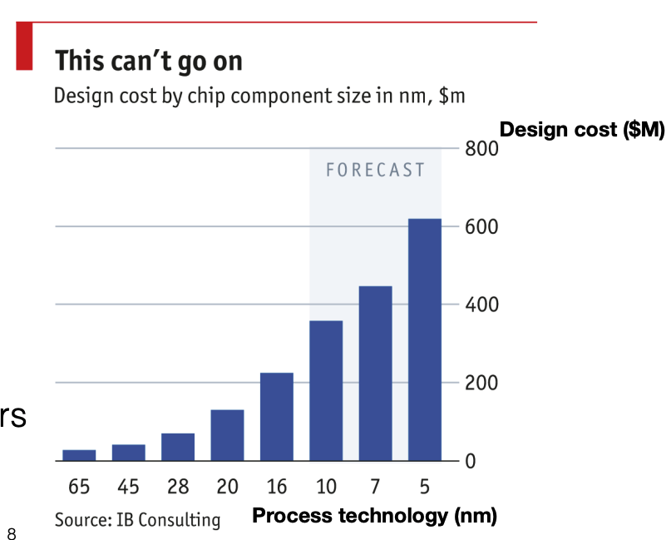
Specialization Challenge
Tape-out costs for accelerators ASICs is exorbitant 10x cost gap between 16nm and 65nm
  Risky bet to design hardware accelerators for ever-changing applications

Slide 72
Remaining question: is a single device sufficient?
A device has limited physical capacity to store “cores” (chip size)
  Our cores are generalized, e.g., can either be CPU cores, GPU cores (cores w/o cache coherence + many SIMD ALUs, etc.), domain-specific cores
How to make a single device faster?
  Increasing clock rate (has a limit)
  Put more cores on a single chip, but has physical limits, e.g., chip size

Slide 73
Question: is a single device sufficient?
A device has limited physical capacity to store “cores” (chip size)
  Our cores are generalized, e.g., can either be CPU cores, GPU cores (cores w/o cache coherence + many SIMD ALUs, etc.), domain-specific cores
Why? Recall our previous calculation
  Basically, a A100 needs 30 seconds for an A100 GPU to finish an iteration on a single input (a.k.a, token) in the optimal case
  How many tokens are trained? 13T tokens! [1]
  To use one A100 to train GPT-4, we need about 412 years to finish the training
[1] https://the-decoder.com/gpt-4-has-a-trillion-parameters/

Slide 74
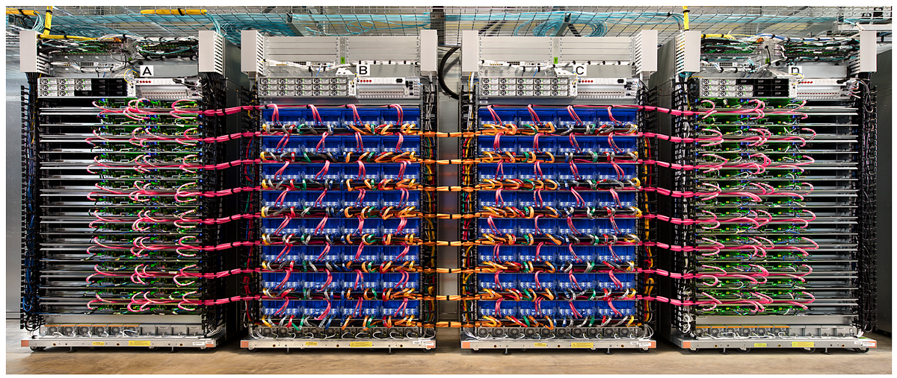
The case for distributed computing
Example: Google’s TPU v4 cluster

Slide 75
Spectrum of computation device available
Mate60 GPU
2.3 TFLOPs
Apple M2
GPU 3.6 TFLOPs
NVIDIA A100
GPU 19.5 TFLOPs
Google TPUv4
275 TFLOPS
A cluster
? TFLOPS
Performance
Notes:
Source: Wikipedia
Mate60: https://nanoreview.net/en/soc-compare/qualcomm-snapdragon-875-vs-hisilicon-kirin-9000
Intel CPU: https://setiathome.berkeley.edu/cpu_list.php

Slide 76

Not so easy: many tedious things to cope with
e.g., programmers need to manually do the following:
  Partition the data
  Deploy programs on multiple machines
  Schedule the works, e.g., what if the jobs have dependencies?
  Fault tolerance
  Network communication is much slower than local memory accesses

